Slide 1


Movie Production Recommendations for MS Films
By Manoj Singh (Data Scientist)

Slide 2

Background
MS Films, a film production company wants to do research on movie industry for new movie production.
The wanted to understand the features of a movie so that viewers and critics would like it and it should generate good revenue.
The goal is to know the growth of movie industry and the profitability
Dataset used: 1000 movies from year 2006 to 2016

Slide 3
About dataset
# | Column | Description
1 | Rank | Movie rank order
2 | Title | The title of the film
3 | Genre | A comma-separated list of genres used to classify the film
4 | Description | Brief one-sentence movie summary
5 | Director | The name of the film's director
6 | Actors | A comma-separated list of the main stars of the film
7 | Year | The year that the film released as an integer.
8 | Runtime | The duration of the film in minutes.
9 | Rating | User rating for the movie 0-10
10 | Votes | Number of votes
11 | Revenue | Movie revenue in millions
12 | Metascore | An aggregated average of critic scores ranging from 0 to 100. Higher scores represent positive reviews.

Slide 4
Data processing
The dataset has 1000 rows (movies) and 12 columns
Missing values:
Revenue column : 13% (High)
Metascore column : 6% (Low)
Correction for missing values in columns:
Revenue : Missing values filled by Median Revenue
Metascore : Dropped rows with missing values
Dropped column: Descriptions and Actors
After cleaning: 936 rows and 12 columns
The processed dataset was analyzed for the relationship of Director, Runtime and Genre of movies against their Revenue, Rating and Metascore.

Slide 5
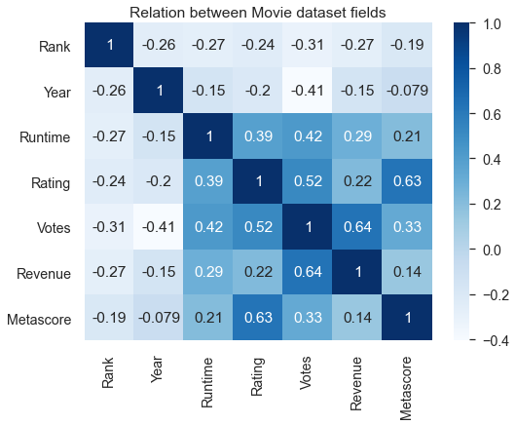
Correlation between Numeric columns
Following columns have mild high correlation
Rating and Metascore
Revenue and Votes
Votes and Rating
While below columns have very low correlation
Revenue and Metascore
Runtime and Metascore
Rating and Revenue
Runtime and Revenue
Rank and Year are negatively correlated with other columns

Slide 6
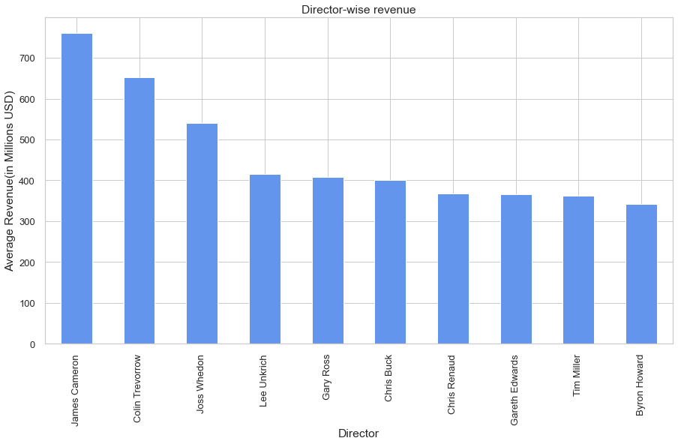
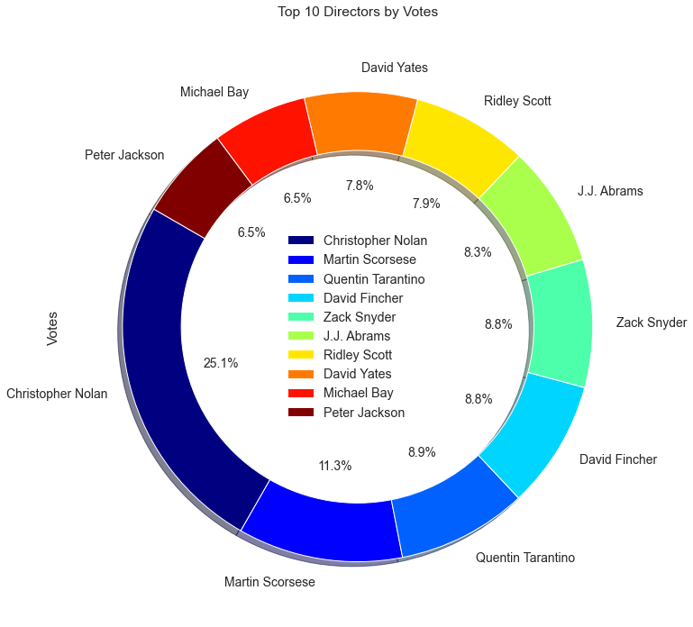
Director wise Revenue and Votes
James Cameron has the highest revenue.
Viewers liked Christopher Nolan's movies

Slide 7
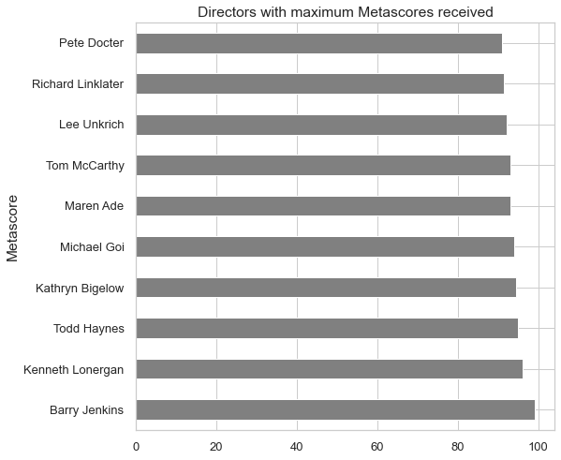
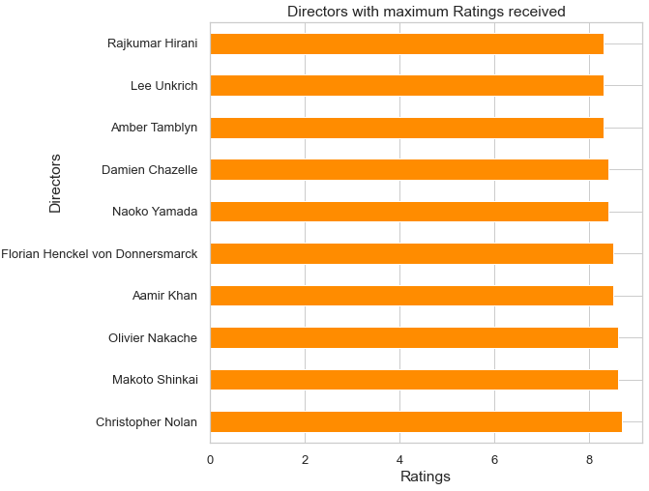
Director wise Metascore and Ratings
Christopher Nolan's movies were highly rated
Movie critics mostly liked Berry Jenkin's movies

Slide 8
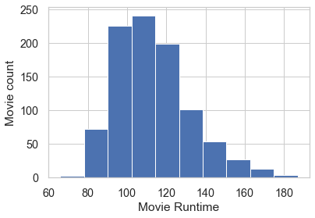
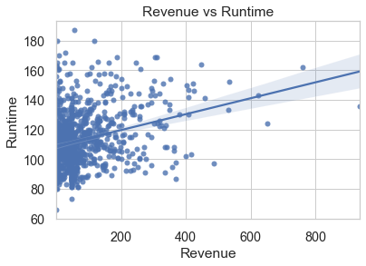
Runtime of Movies
Mostly movies have runtime of 100 to 120 minutes
Movies with runtime, 100 to 150 have earned maximum revenue

Slide 9
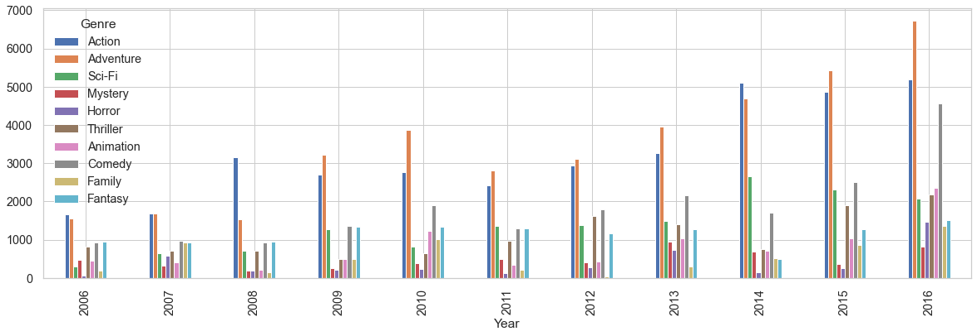
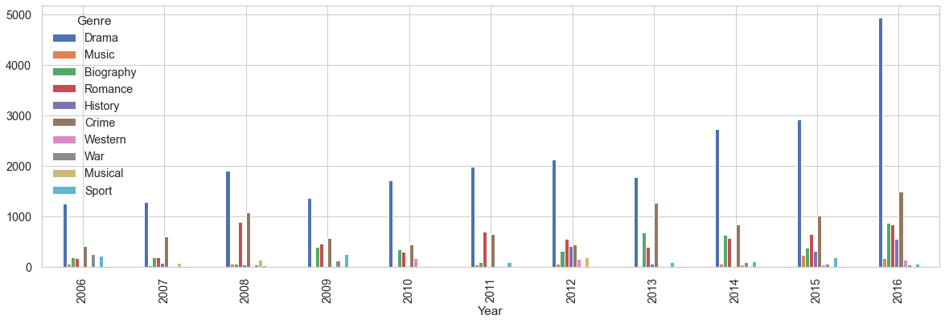
Genre wise Revenue per year
Adventure genre has earned most revenue followed by Action, Drama, and Comedy
In 2016 there is increase in production of Horror, Thriller and Comedy movies but Comedy earned more revenue among them
Any combination of genre Adventure, Action, Drama, and Comedy may give the good revenue

Slide 10
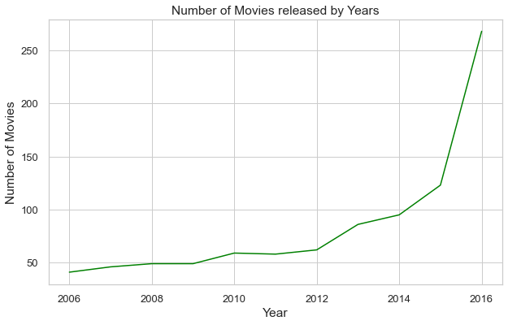
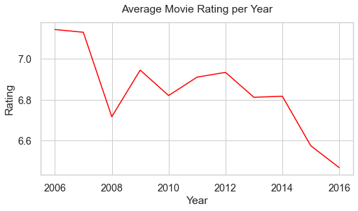
Growth of Movies by count
The number of movies releasing per year has increased significantly
As more movies are produced the average rating was decreased so as the votes and the metascore resulting decreased popularity

Slide 11
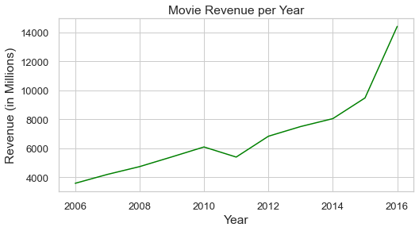
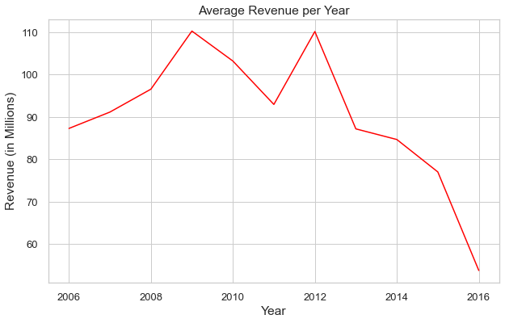
Growth of movies by revenue
While the total revenue of movies increased over the years but the average revenue of movies decreased apparently.
This is most probably because of the fact the total number of movies released per year is increasing.
.

Slide 12
Conclusion
Recommendation for MS Films:
The movie industry is growing very fast. To get the good business, produce more movies using the best features explained below:
Produce movies with active directors. Christopher Nolan's movie may get more Revenue, Rating and Metascore.
Produce movies that should have at least 120 minutes runtime.
To get the maximum revenue, produce movies having the combination of the genres Adventure, Action, Drama, and Comedy
Produce movies that will satisfy both Viewers and Critics

Slide 13
Thank You
Manoj Singh : singh.it@gmail.com

